Slide 1
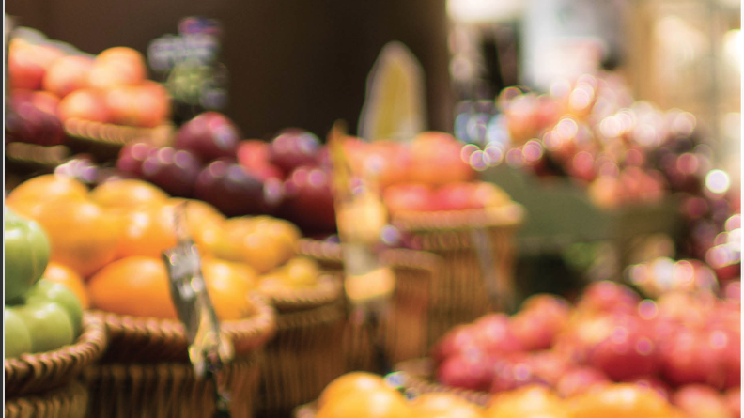
Grocery Sales Market
Ingredients for life

Slide 2
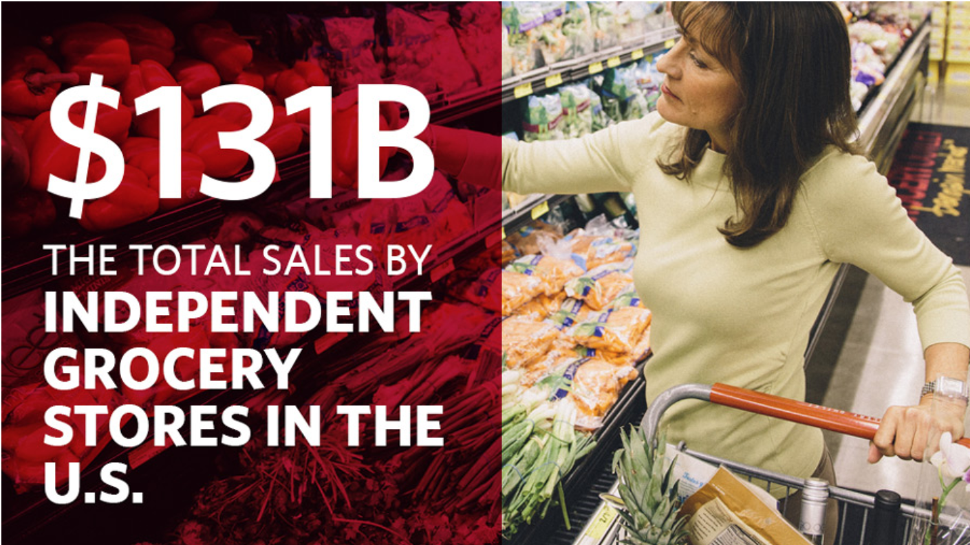
How Big is the Grocery Industry?

Slide 3
Our Study:
we find the grocery market an interesting study. We hope to derive the insights that will help to FORECAST THE SALES MARKET AND In order to do THAT we analyzed a series of dataset from Kaggle which describes grocery market sales.

Slide 4
Presentation Outline
Which are the Allergic and Non-Allergic Products in different categories?
To identify total sales revenue per product in grocery sales market.
What is the normal distribution of customers over all cities?
Analyze product pricing as it relates to sales transaction volume.
Analyze sales transaction productivity per employee.
Conclusion

Slide 5

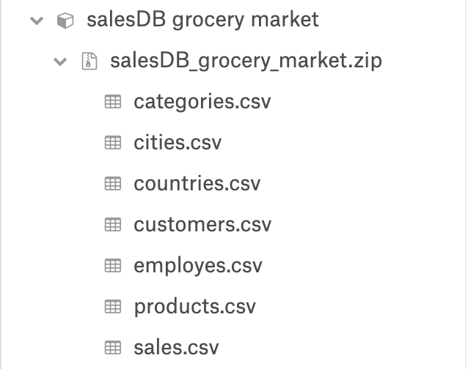
Data Sources

Slide 6
Allergic and Non-Allergic Products

Slide 7
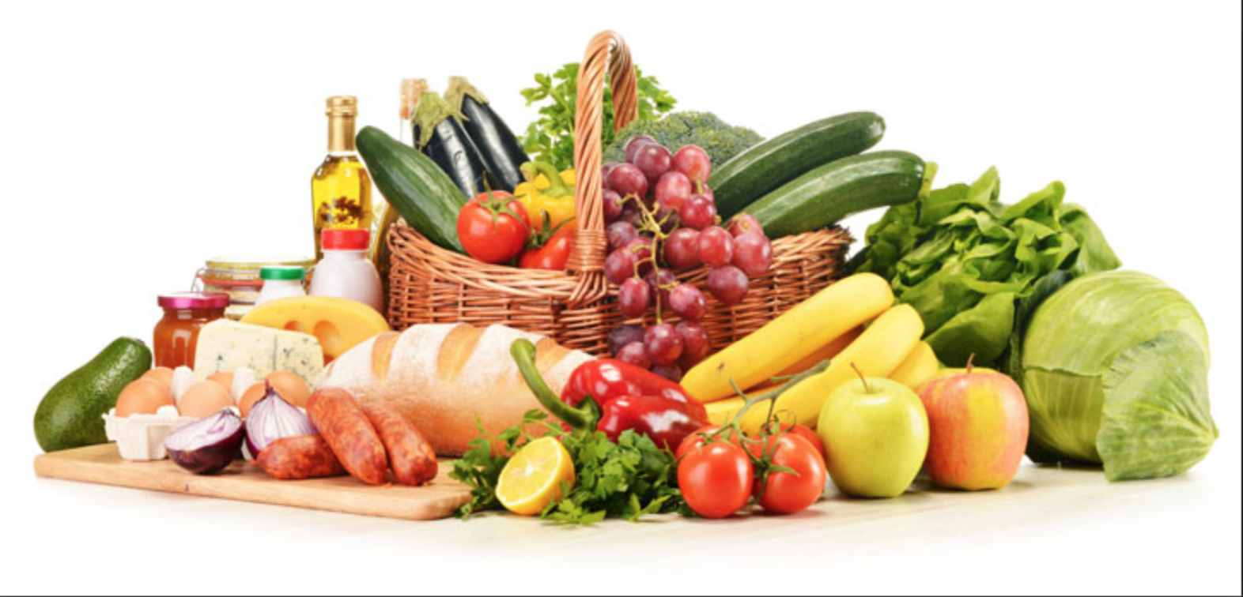
What Products Make Up This Industry ?
Confections
Shell fish
Cereals
Dairy
Beverages
Seafood
Meat
Grain
Poultry
Snails
Produce

Slide 8

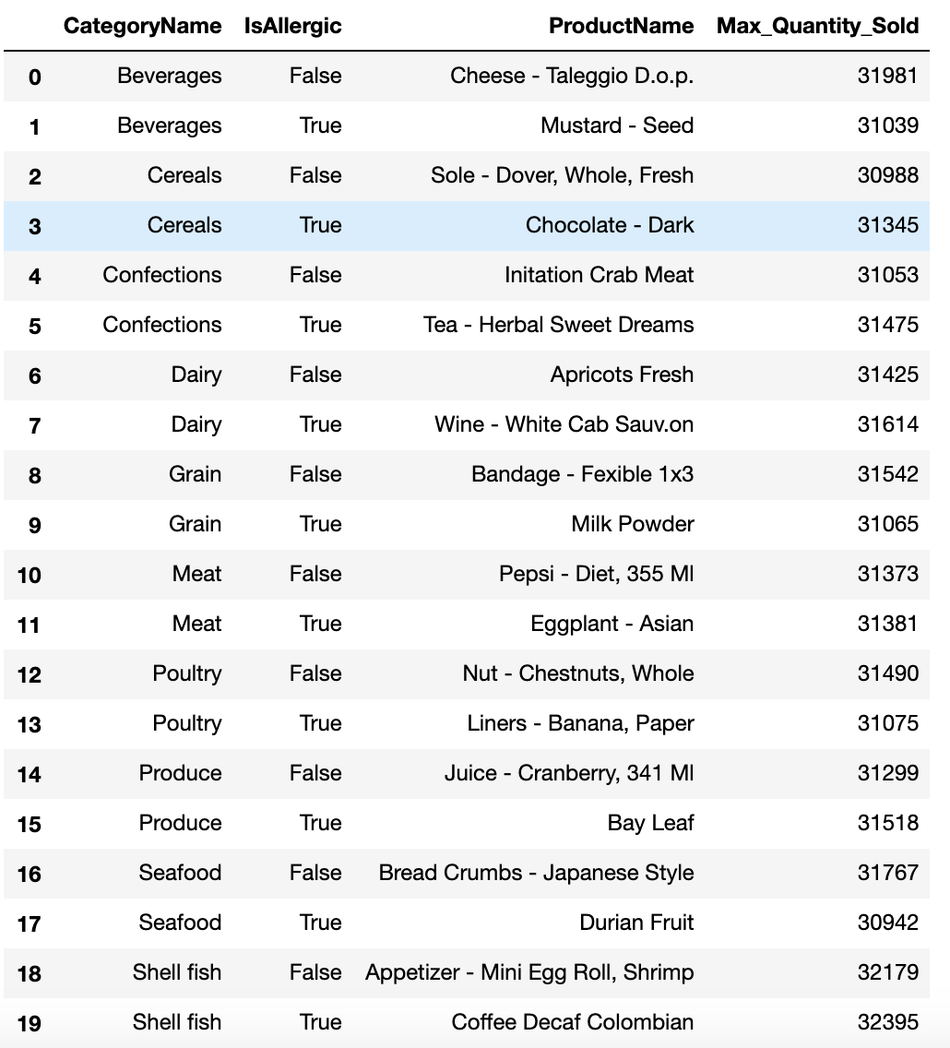



Common allergic & non-allergic products among different categories

Slide 9
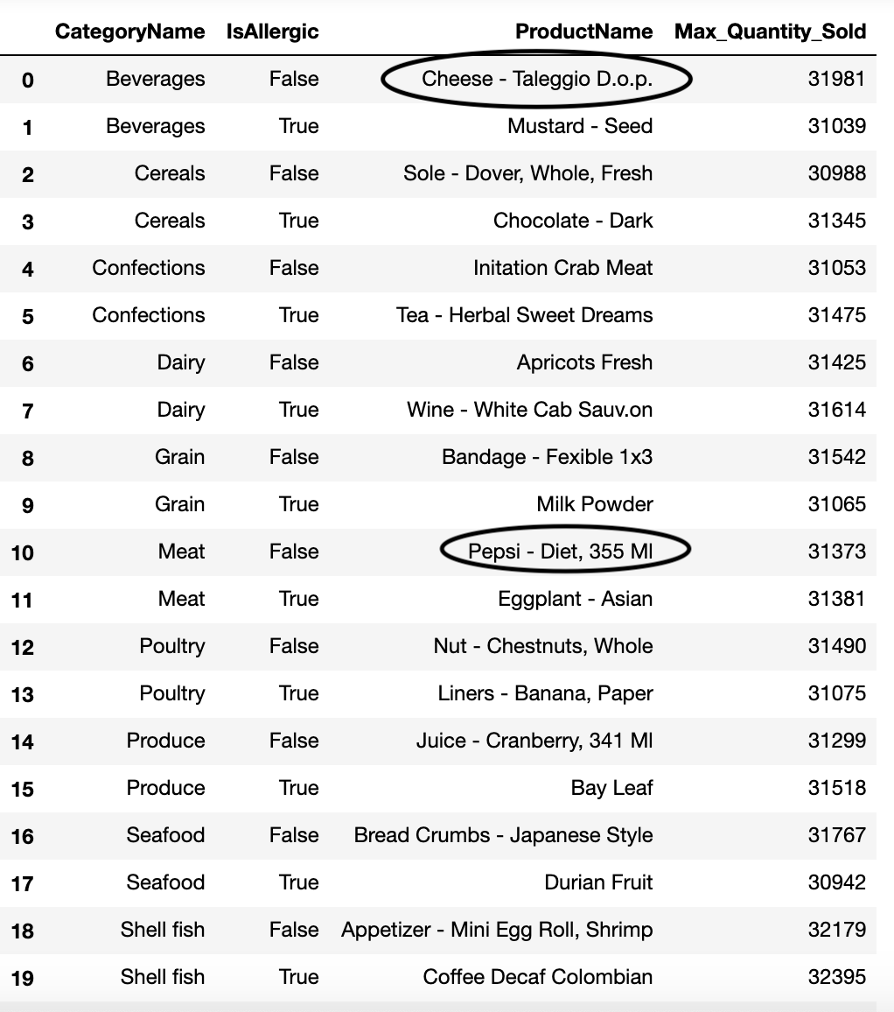
Common allergic & non-allergic products among different categories

Slide 10
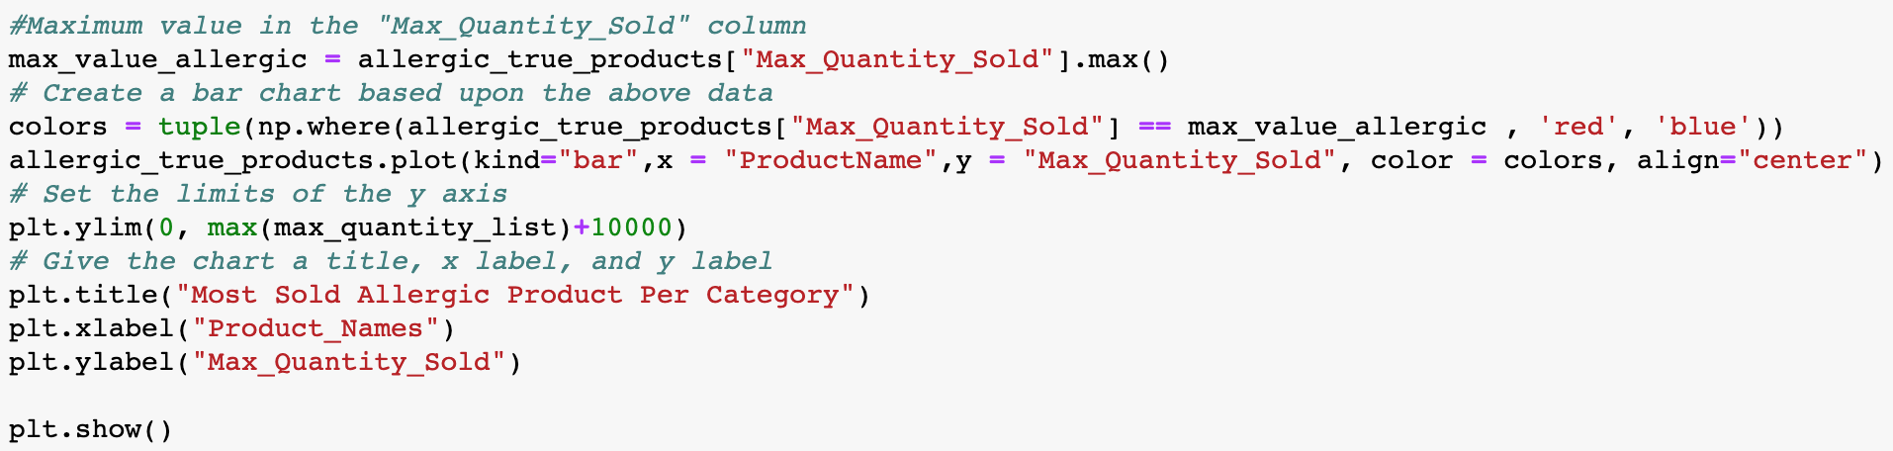
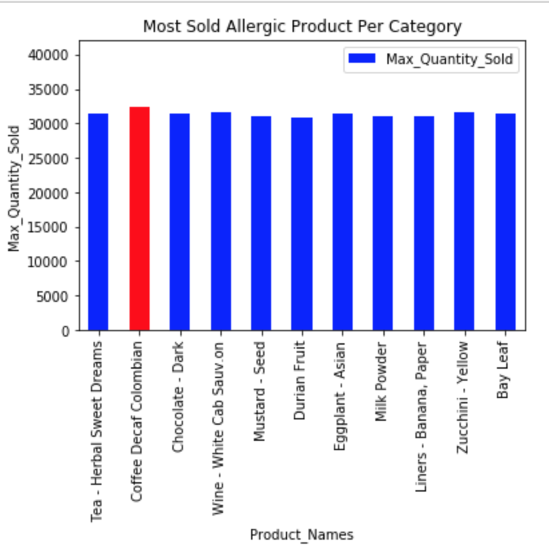
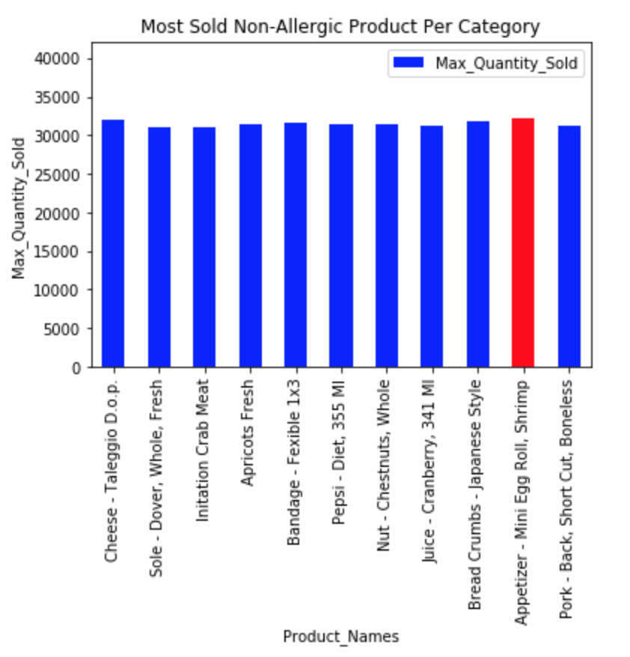
Allergic Products
Non-Allergic Products

Slide 11
Products and Sales
To identify total sales revenue per product in grocery sales market.
A scatter plot showing the distribution
Bar graph showing lowest to highest product sales
Which is most popular product based on sales?
What is the lowest priced product?
What is the product resistance(perishable/durable) in the sales?
A scatter plot showing the distribution
Identify the most perishable and durable items

Slide 12

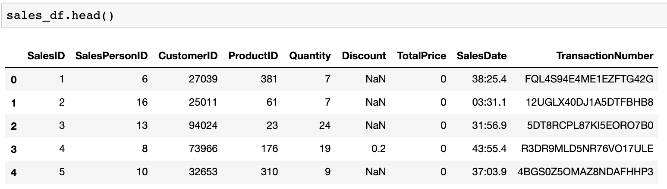
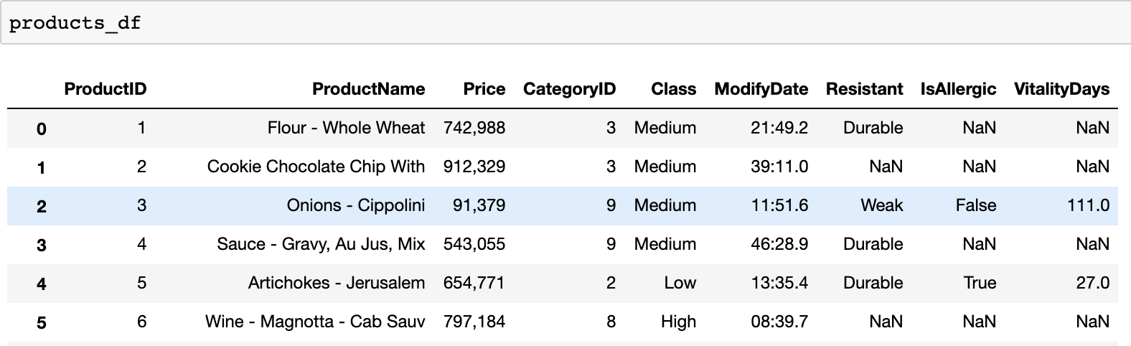
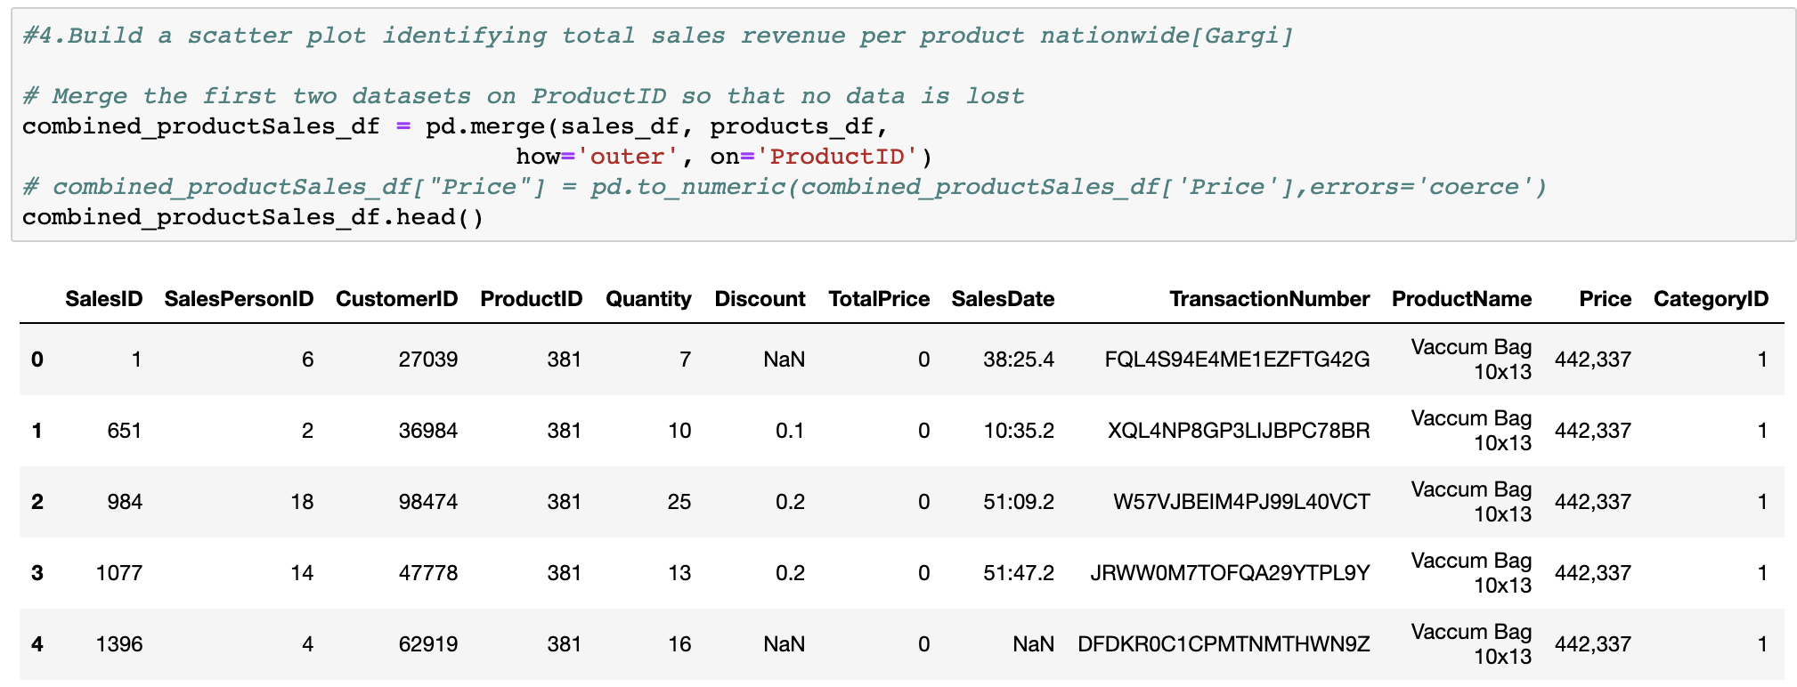
Products and Sales Combined

Slide 13
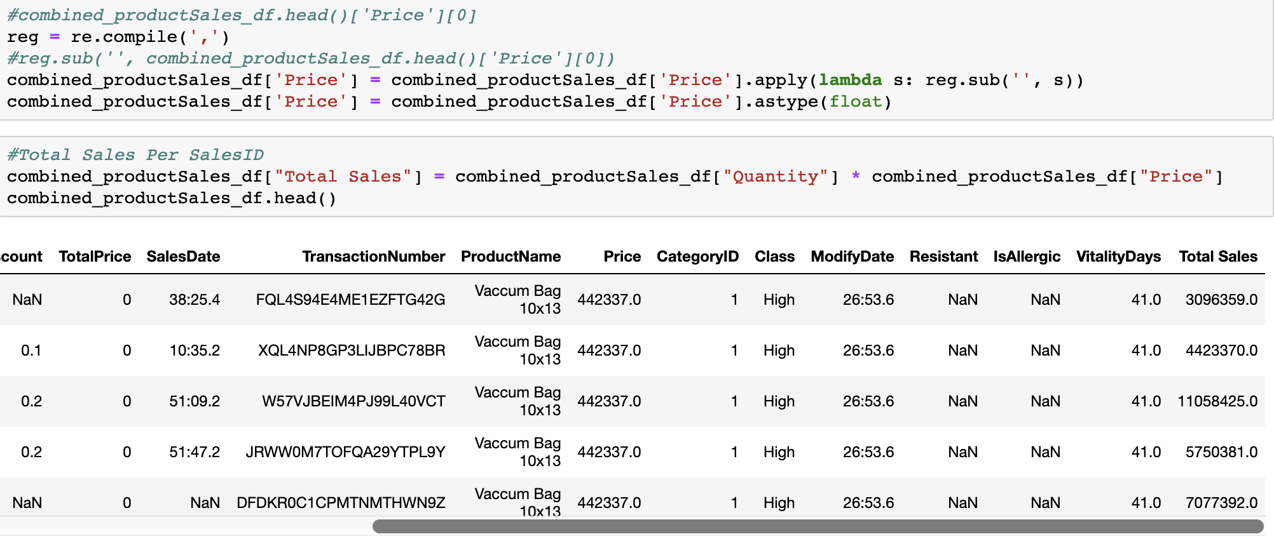
Calculating Total Sales Per Product

Slide 14
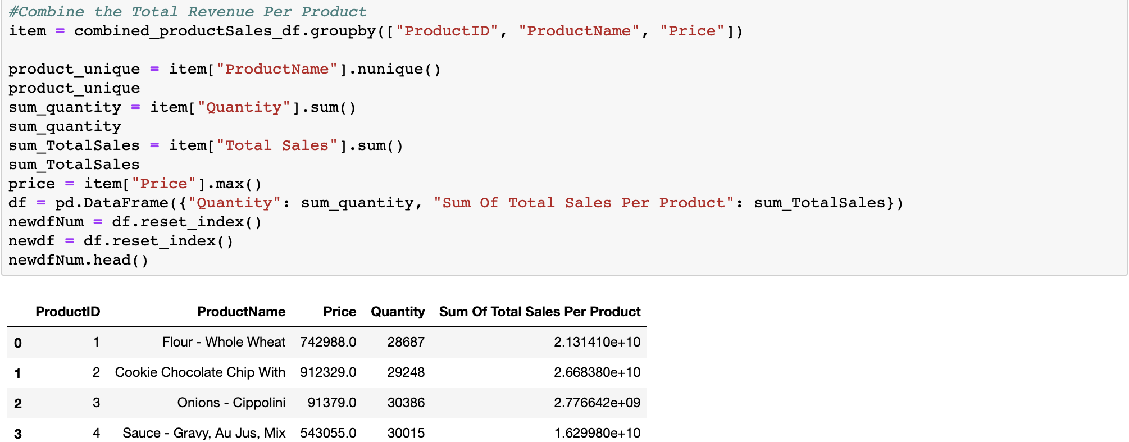
Total Sales Per Product

Slide 15
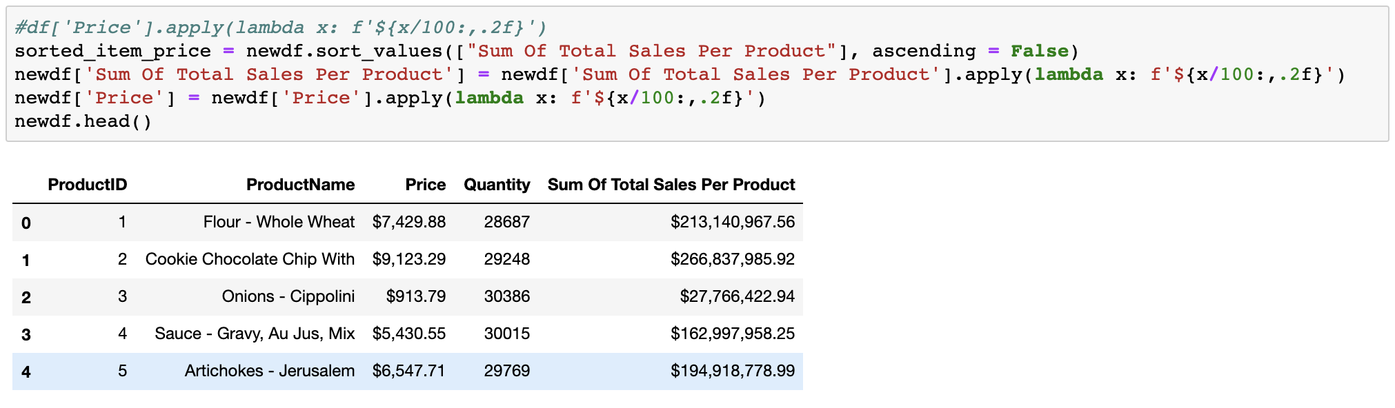
Data Cleanup and Beautification

Slide 16
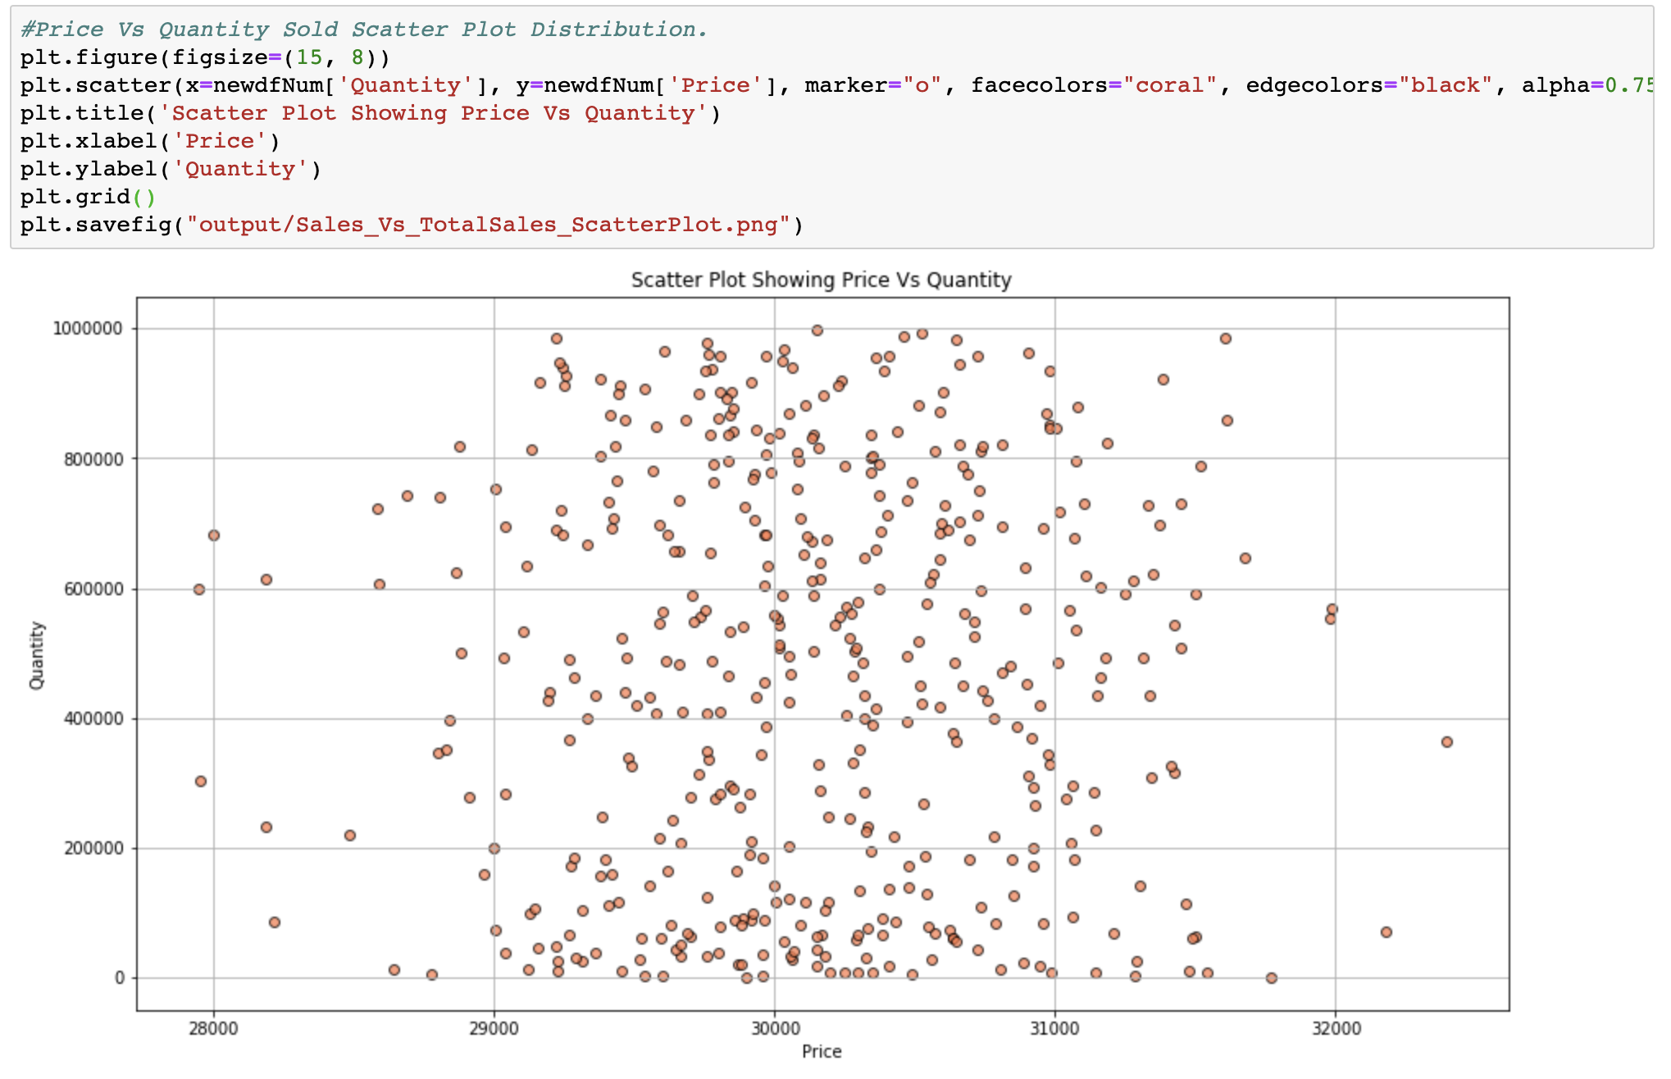
Price Vs Quantity – What does it say?

Slide 17
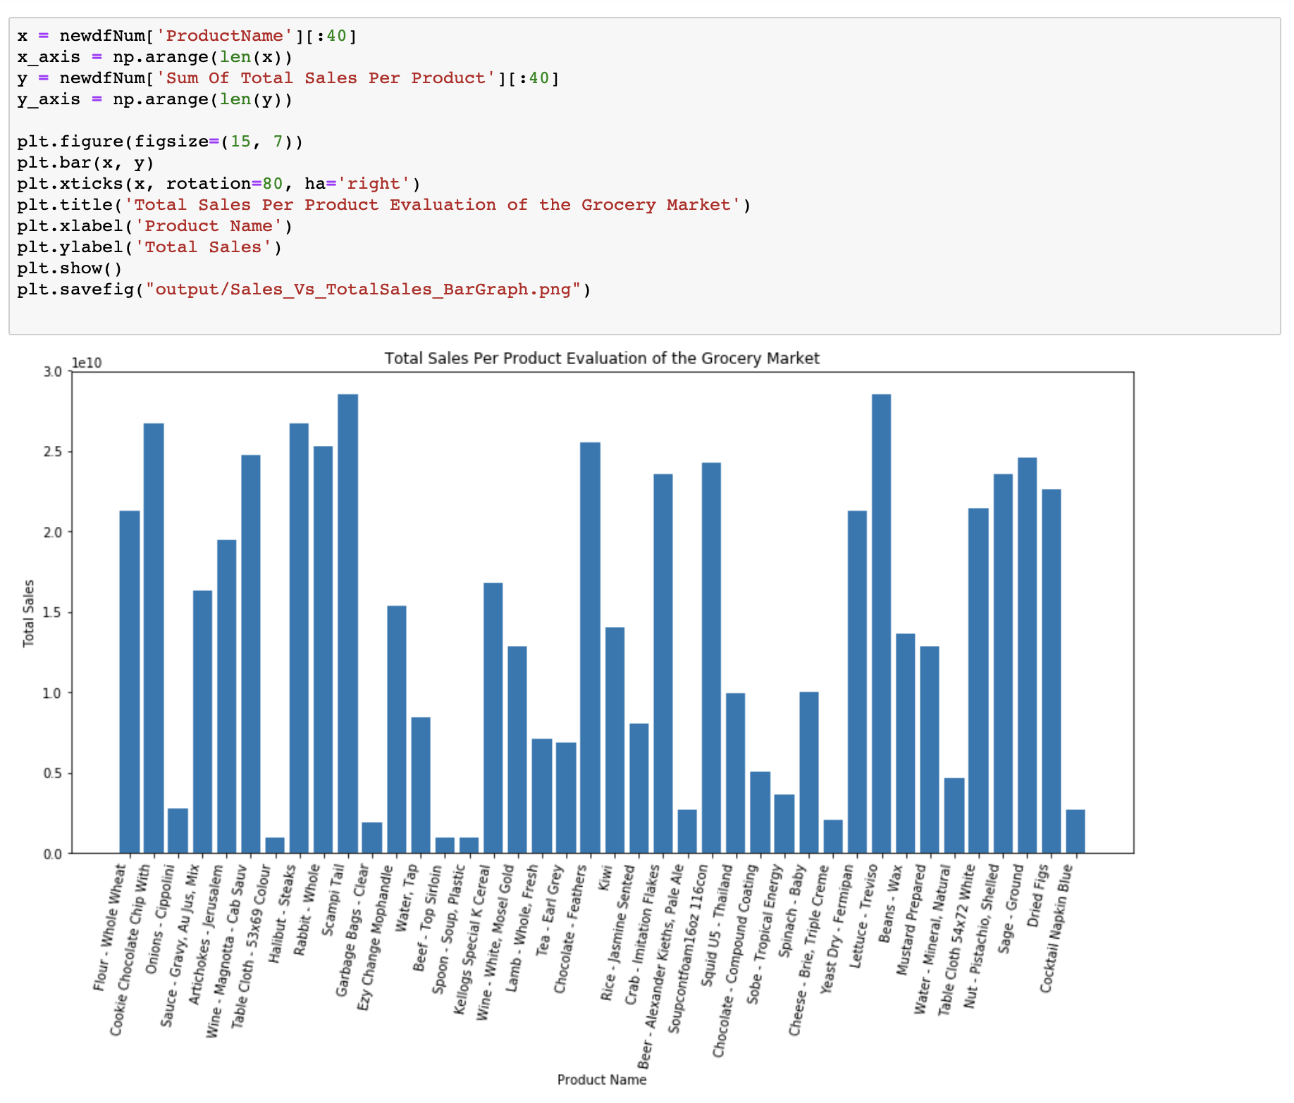

Slide 18
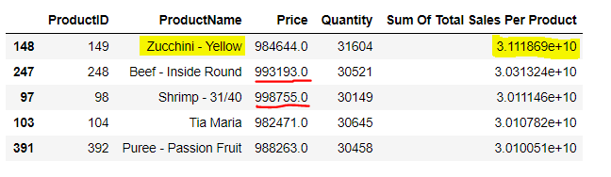
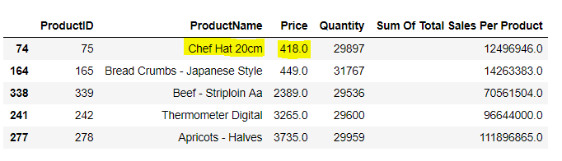
Which is most popular product and least priced product based on sales?

Slide 19
Customers vs Cities
Top 5 cities with the most and least customers.
Normal distribution of customers over all cities.
T test to compare customers in California to customers in all cities

Slide 20
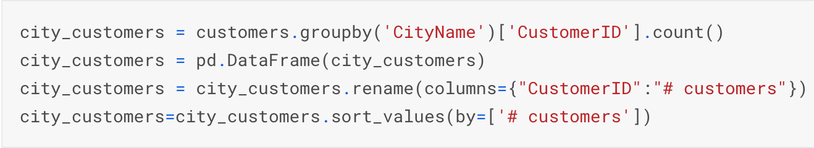
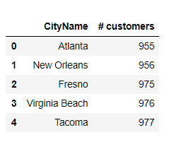
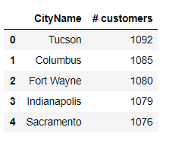
5 Cities with most customers
5 Cities with least customers

Slide 21
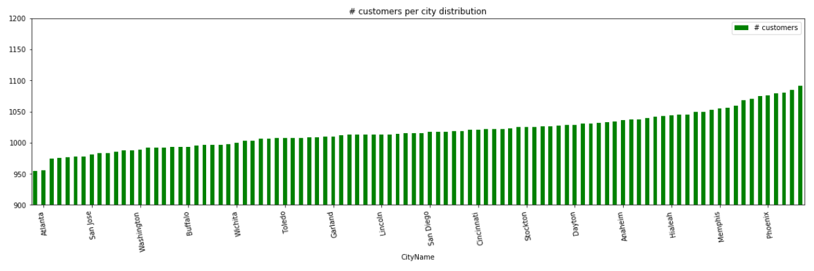
Number of customers per city distribution

Slide 22
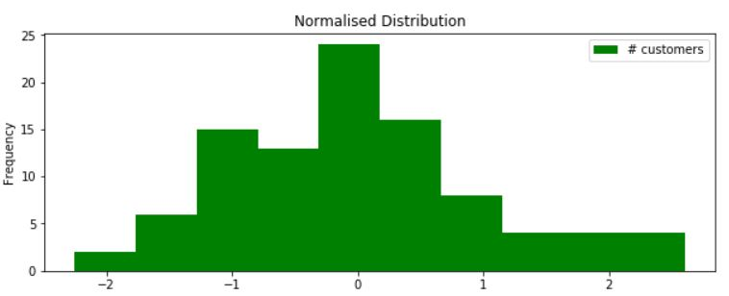
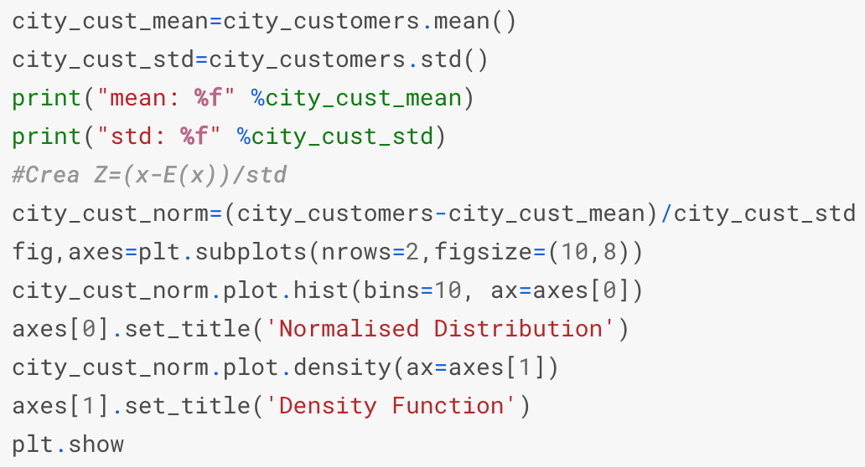
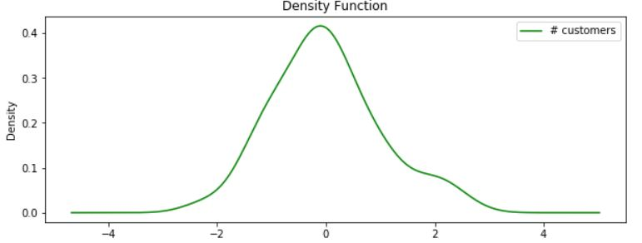
Normal Distribution of Customers
Density Function of Customers

Slide 23
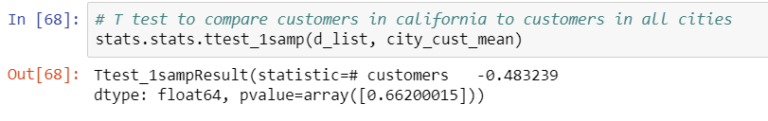
T- test to compare customers in California to customers in all cities

Slide 24
Revenue per Transaction & Employee Productivity
Show the correlation between price and transaction volume per product sold.
Two tables listing the Top and Bottom Products ranked by Revenue/Transaction.
A bubble plot showing the distribution between price and transaction volume
and it’s correlation to revenue per transaction.
Show productivity per employee by transaction.
A bar chart showing the total transactions per employee
A bar chart showing the average transaction size per employee.

Slide 25
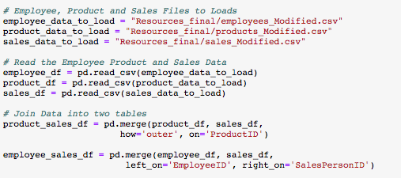
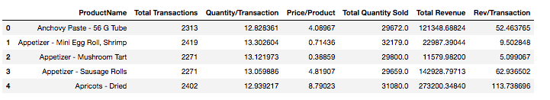
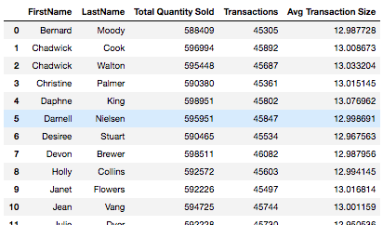
Datasets
Sales Table
Product Table
Employee Table

Slide 26
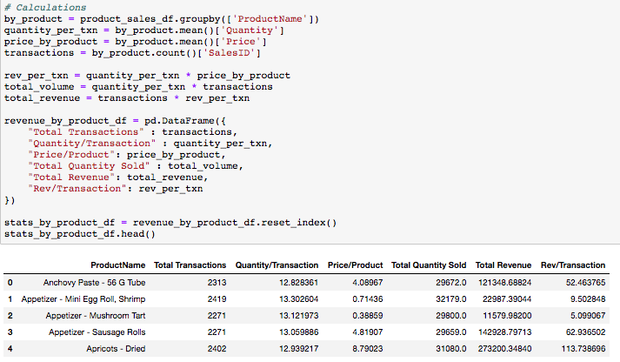
Calculating Revenue per Transaction

Slide 27
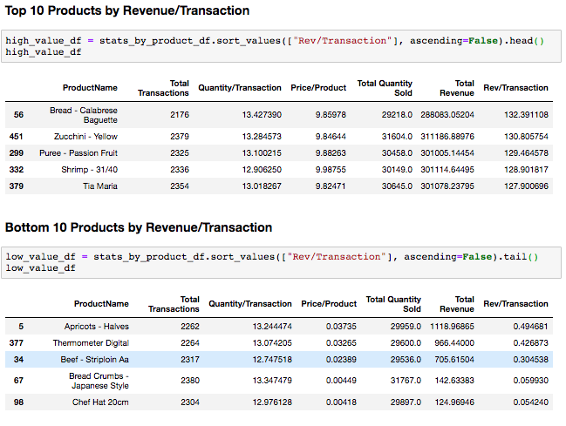
Top & Bottom Products based on Rev/Transaction

Slide 28
Steak & Zucchini
I can buy steak for 2.5 cents !
Zucchini costs me almost $10 !
Let’s go shoppin’ !
Something smells fishy here though…

Slide 29
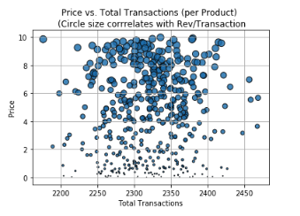
Price & Transactions
People are buying the same quantities of products regardless of price?
The large majority of the revenue is coming from a subset of products.
Steak costs 2.5 cents!!! Something is up!

Slide 30
What’s going on here?
Why don’t we stop selling steak, and start selling more zucchini?
If we DID…
Would total store profits drop? Maybe because steak is a lost leader driving in all of the zucchini traffic...?
Does it cost more to sell zucchini and are the Cogs margins on zucchini weaker than steak?
Or… would profits increase due to improved labor efficiencies? Let’s look at our Employees.

Slide 31
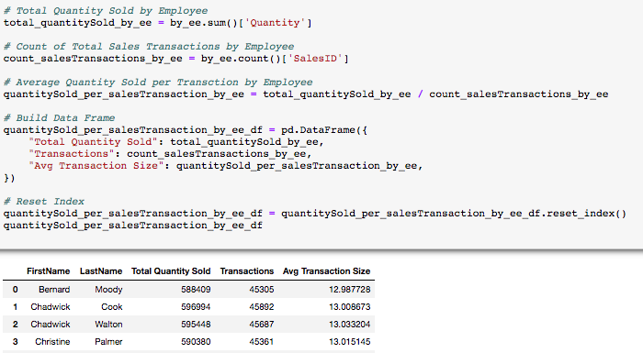
Transactions per Employee Calcs

Slide 32
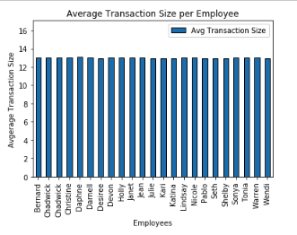
Average Transaction Size per Employee
The average transaction size is about the same for each Employee.
That means each employee sells the same number of products per transaction.

Slide 33
Total Transactions per Employee
Each employee has been processing almost the exact same number of transactions.
That means each employee generates the same number of sales per average hour worked.

Slide 34
Cost of Labor is fixed?
The employee and sales analysis shows that the average labor cost associated with the acquisition of one sales transaction across an average of all products is relatively fixed.
Assuming that the COGs margin for each product sold is the same for each product, and there are no lost leaders why not sell just the top few products?
Maybe because it takes more time to process a Zucchini transaction vs. a Steak transaction because Zucchini’s take less time to process than steaks? That analysis is for another time…
Or… would Profits increase because were are allocating our fixed labor costs towards selling products that generate substantially more revenue per transaction?

Slide 35
Get rid of Steak?!!! Something is fishy here. Let’s look at the Data.
Categories
Sales Data
Products Data
Shell Fish Category?
‘wasabi’
‘Kellogs’
‘Jerusalem artichokes’
Products
Each product had almost the same number of transactions. Fake.
Employee
Each employee had almost the same number of transactions. Fake.
Price
Artificially generated?
Each product has a different price.
Steak 2.5 cents!
Zucchini $10 bucks!
FAKE!

Slide 36
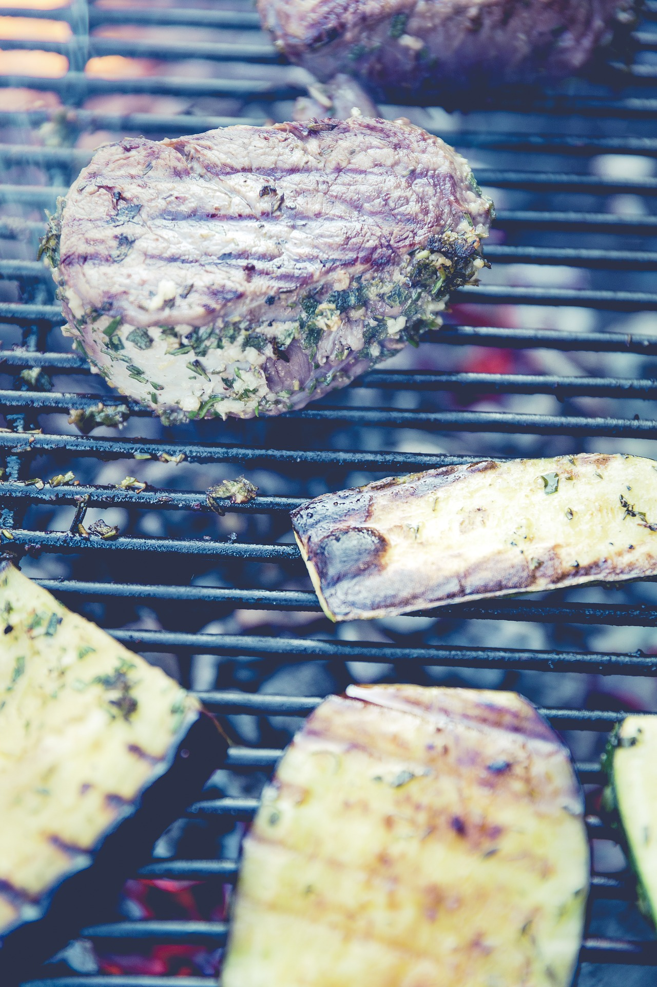
Conclusion:
It looks like false advertising...
Measure twice, cut once.
Use common sense and spend more time reviewing data before digging in too deep with analysis.

